Slide 1
Safewards Victoria A model for safety and mutual support
Marisol Corrales – DHHS
Geo George – VMIA
Lisa Spong – Bendigo Health, DHHS
Notes:
Change title

Slide 2
The Office of the Chief Mental Health Nurse in partnership with VMIA
Leadership
Representation
Support
Best Practice
Notes:
Marisol we are supported by vmia and Geo will speak about vmia’s role in safewards
The Office of the Chief Mental Health Nurse is part of the Office of the Chief Psychiatrist (OCP) within the Department of Health and Human Services.
The role of the Office is to improve the experience of care for patients, their family and carers by supporting quality improvement and encouraging best practice approaches to care in services.
The Office does this by
Leadership - Providing mental health nursing leadership and advice to government, the public and private health and education sectors
Representation - Represent mental health nursing on advisory and reference groups both within and external to the DHHS, at State and national levels
Support – Support the delivery of recovery focused clinical quality and safety within services
Best practice - Undertake initiatives to support and enhance mental health nursing best practice
The activities of the Office support a range of mental health reform initiatives in Victoria, including the introduction of the Mental Health Act 2014, and Victorian Government priorities around recovery-oriented practice, safety and reducing restrictive practices.
The Office provides practice leadership and evidence-informed directions and recommendations that address a wide spectrum of Victoria’s mental health service system, including mental health nursing practice, policy and service design that have an impact on the workforce, to promote continuous improvement in client outcomes.

Slide 3
VMIA
VMIA’s diverse client base and coverage includes assets, services, infrastructure and people.
Notes:
Geo
Museum, arts centres and all state assets including
The Victorian Managed Insurance Authority (VMIA) is a Statutory Authority established by the Victorian Managed Insurance Authority Act 1996
VMIA provides risk advice and insurance services for the Victorian Government, to improve the quality of life for the Victorian community
Current portfolio represents approximately $173 billion in assets, backed by state insurance
VMIA provide Risk management and Insurance for Victorians
VMIA's clients include:
7 Victorian Government departments
170 departmental portfolio agencies (statutory authorities and agencies)
22 rail operators
280 hospitals and health centres, and bush nursing hospitals
19 medical research bodies
220 rural doctors
500 cemetery trusts
2,300 community service organisations
13,500 registered residential builders
1,000 school councils

Slide 4
Medical claims
Notes:
Geo

Slide 5
Key Themes for VMIA
The most frequent and high cost VMIA mental health claims include;
Nervous shock and dependency claims made by family members e.g. multiple claims for once incident
Inappropriate treatment e.g. physical and chemical restraint used inappropriately
Assault e.g. both sexual and physical
Self-harm
Misdiagnosis
Absconding, including failure to supervise resulting in suicide or injury
Notes:
Geo

Slide 6
Drivers
DHHS
Reducing Restrictive Interventions
Recovery Framework (2010)
VMIA
Rising claims and costs
A Community and Government priority
Sector interest
Opportunity to do more
Mental Health Act (2014)
10 Year Mental Health Plan
Notes:
Geo
For DHHS - A response to two high priority issues 1. Restrictive interventions and 2. Occupational violence
Underpinned by the Mental Health Act and the 10 year Mental Health Plan
Mental Health Act (2014): The most recent Victorian Mental Health Act (2014) has clear objectives to provide for the least restrictive approach to mental health assessment and treatment. By reducing containment in mental health services, particularly restrictive interventions, Safewards has a direct role in enabling mental health services to meet these legislative objectives.
Ten Year Mental Health Plan (2015): The Safewards model builds greater respect for both staff and patients. Safewards addresses several of the items identified as a priority for this strategy, including a workforce that enables recovery oriented and trauma informed services, and an increase in safety for the workforce and for patients.
▪Victoria’s 10-year mental health plan sets out the vision for mental health system delivery in Victoria which has undergone significant reform with a stronger commitment to recovery-oriented practice, worker safety and satisfaction
Reducing Restrictive Interventions The framework describes four interconnected capabilities that support the mix of interventions that
will enable a sustainable reduction in restrictive practices.
• leadership and accountability
• systems
• self-determination
• workforce
Recovery Framework (2010): The Victorian Framework for Recovery-Oriented Practice (Vic Gov, 2010) outlines policy and practice expectations for mental health services in relation to recovery. The framework states that recovery ‘..involves promoting people’s choice, agency and self-management’ (p3). Safewards supports this intent by reducing the conflict and restrictive interventions
for VMIA An area of rising claims and costs
▪A community and government priority - almost half of all Victorians (45 per cent) will experience mental illness at some point in their lives
10 year plan
▪VMIA acknowledges there is an opportunity to do more

Slide 7
Why Safewards?
Evidence based model
Aligns with VMIA’s Better Patient Safety objectives and DHHS Reducing Interventions objectives
Sector Interest
Successful pilot by DHHS
Safewards minimises harm to patients and staff
Preventative model
Notes:
Lisa
Why we chose Safewards as it can address two key themes RRI and Occupational violence
Safewards is an evidence based model with an extensive literature review examining evidence related to conflict and containment within inpatient settings
Safewards aligns with VMIA’s Better Patient Safety objectives
Nurses within mental health services have driven implementation of Safewards in Victoria. It was the interest in Safewards expressed by individual services during the State-wide Reducing Restrictive Interventions Initiative that provided the initial impetus for the Department of Health and Human Services to explore the establishment of a broader Safewards trial.
The design of the trial was developed in partnership with services. Each service was responsible for implementing Safewards in their mental health units, which included adult, aged, secure extended care and youth settings.
The success of the trial and the continuing momentum in the uptake of Safewards in mental health services to date, reflects the hours of work put in by staff. The growing Safewards Victoria Community of Practice is wholly organised by mental health service staff, which is evidence of the value placed on Safewards by staff engaged with implementing it.
The evaluation of the Safewards Victoria trial has found that Safewards can contribute to enhancing the culture and atmosphere in our mental health services. Staff and consumers reported that Safewards reduced conflict and improved communication. It seems that Safewards can also impact on the reduction of the use of restrictive interventions.
Safewards allows for earlier intervention and reduces the risk of escalation of a worsening situation which minimises harm to the individual, families, carers and staff
Following a successful trial it made sense, it minimises harm to patients and staff, it is not expensive but works better with support and genuine interest from the leadership teams, with dedicated parties assigned to it, driving it and maintaining enthusiasm

Slide 8
What is Safewards?
Conflict
Containment
Events that threaten staff or patient safety, including verbal abuse, physical aggression to others, self-harm, suicide and absconding
Things staff do to prevent events or minimise harmful outcomes, including use of extra sedating medication, special observation, restraint and seclusion
Notes:
Lisa –
The Safewards’ model is derived from extensive research into episodes of conflict (aggression, self-harm, absconding, substance use, medication refusal) and containment (PRN medication, restraint, seclusion, coerced IM medication, special observation) on acute adult in-patient units.
The explanatory model helps examine the common flashpoints (an event that could precede conflict), ways for patients and staff to influence the situation that can lead to conflict and/or containment. Safewards provides a model for engaging with the complexity of these situations and provides practical options, in the form of interventions. It identifies 6 domains that impact conflict and containment (patient community, patient characteristics, staff team, physical environment, outside hospital, regulatory framework).

Slide 9
The Safewards Model (Simple)
Staff Team
Patient Characteristics
Patient Community
Physical Environment
Outside Hospital
Regulatory Framework
Physical aggression
Verbal aggression
Property damage
Absconding
Self Harm
Suicide
Medication refusal
Limit setting
Exacerbation
Noise
Locked door
Loss of relationship
Denial of leave
Physical & mechanical restraint
PRN medication
Seclusion
Use of security
Special/ increased observation/HDU
Notes:
Lisa
Click on icon to flash boxes in

Slide 10
Six domains that influence or trigger conflict
Flashpoint
Domains
1. The patient community
2. Patient characteristics
3. Regulatory framework
Definition:
Social and psychological situations arising out of features of the originating domains, signaling and preceding imminent conflict behaviours
4. Staff team
5. Physical environment
6. Outside hospital
Notes:
Lisa
Give a brief summary of each of the domains and describe how factors in the domains can lead to flashpoints.

Slide 11
Staff can influence conflict and containment by:
Reducing or eradicating the originating conflict factors.
Preventing flashpoints.
Cutting the link between the flashpoint and conflict.
Choosing not to use containment when it would be counterproductive.
Ensuring that containment does not lead to further conflict.
Notes:
Lisa
This slide highlights the various ways that staff can have an influence on conflict and containment rates on their ward.
Go through each of the points highlighting examples that are relevant to your participants.
For dot point 4 - choose not to use containment on occasions when it would be counterproductive - here you could ask the participants if they can talk about a time when they have done this and it has been a positive experience.
You can also facilitate discussion around how to prevent further conflict when using containment methods.

Slide 12
Safewards Victoria Trial
7 health services
Metropolitan
Regional
18 wards
4 service types
Adult
SECU
Adolescent/Youth
Aged
Notes:
Lisa
The ten interventions were chosen due to their having the best evidence for effectiveness in the UK trial
Establishing the pilot required consistent engagement with services at multiple levels:
all services (inc those not participating in the pilot) were invited to attend a workshop with Len Bowers, the creator of Safewards, who was over from the UK to speak at the ACMHN conference. The workshop provided an opportunity to discuss the model, interventions and implementation approaches directly with the architect Safewards (some attendees even grabbed Len for photos at the end of the day)
participation agreement signed at the executive level
partnership group was established at the outset, consisting of representatives from each of the participating services. The group meet frequently to provide input into the structure of the pilot, including the approach to training, evaluation and ongoing support. Group consisted of managers and educators
The training program was developed attended by educators and clinicians
OCMHN conducted a series of site visits – visited all 7 services and almost all 18 units, met with staff and consumers
18 units (inc adult, aged, SECU and adolescent)
The implementation of Safewards in Aged, adolescent and SECU had not been attempted previously, enabling the pilot to contribute to and expand the evidence base for using Safewards

Slide 13
Safewards trial – key results from the pilot
36% reduction in seclusion rates, from baseline to follow-up.
Highly favourable impact of staff and consumer perceptions of increased safety and more positive inpatient environments.
Applicability: The Safewards model made sense to staff, most interventions were keenly taken up by staff (n=103), and consumers enthusiastically engaged with several interventions (n=72) .
Sustainability: Fidelity was achieved to a very good standard in the trial period and to an excellent standard by the end of the sustainability period.
Notes:
Lisa
Safewards was associated with reduced seclusion events overall and improvement was especially evident in adult and youth wards.
At that time there was a 36% reduction in seclusion rates, from baseline to follow-up.
Safewards had a highly favourable impact in terms of staff and consumer perceptions of increased safety and more positive inpatient environments.
Applicability: The Safewards model made sense to staff, most interventions were keenly taken up by staff (n=103), and consumers enthusiastically engaged with several interventions (n=72) .
Sustainability: Fidelity was achieved to a very good standard in the trial period and to an excellent standard by the end of the sustainability period.

Slide 14
Safewards Victoria state-wide implementation
Training and pre-implementation support
Implementation
Embedding within services
Evaluation
Phase 1 – Mental health – 18 services 62 units
Phase 2 – Emergency Departments - pilot
Phase 3 – General settings - pilot
Notes:
Marisol
Using the learnings from the trial the state-wide implementation will now cover 3 phases, the first phase concentrates on implementing the model into mental health units across Victoria
Phase 2 will form the pilot for Emergency departments
Phase 3 general settings
Evaluate against objectives for:
Learning Practice change Experience Effectiveness Sustainability

Slide 15
Results so far..
Notes:
Results have been positive with staff indicating that the majority proportion of staff reported an increased feeling of safety and more positive about being on the ward
Conversely the consumer figures indicate similar results

Slide 16
Continued Collaboration
Notes:
Marisol
Victorian government support
VMIA partnership
Led by the Office of the chief mental health nurse
Dedicated project and education team with clinical expertise
Supported by consumer representation
Evaluation by CPN
Faculty which is attended by expert clinicians, VMIA, and
Marisol
Continued collaboration to support the establishment of Safewards across mental health services in Victoria by 2018 within the sector and cross collaboration with VMIA
Safewards training has been delivered to 11 of the 18 services (32 of the 62 mental health units) with a small amount of resources and capital funding for Safewards related works
Tailored support for services throughout the implementation, assisting and supporting mental health services in planning, training and embedding interventions into their units
Sustainability of Safewards via a Safewards Collaborative and Safewards Faculty model with possible certification establishment in the future
Planning is underway to pilot the implementation of Safewards in emergency departments/ general settings at phases 2 and 3 in 2019 and 2020

Slide 17
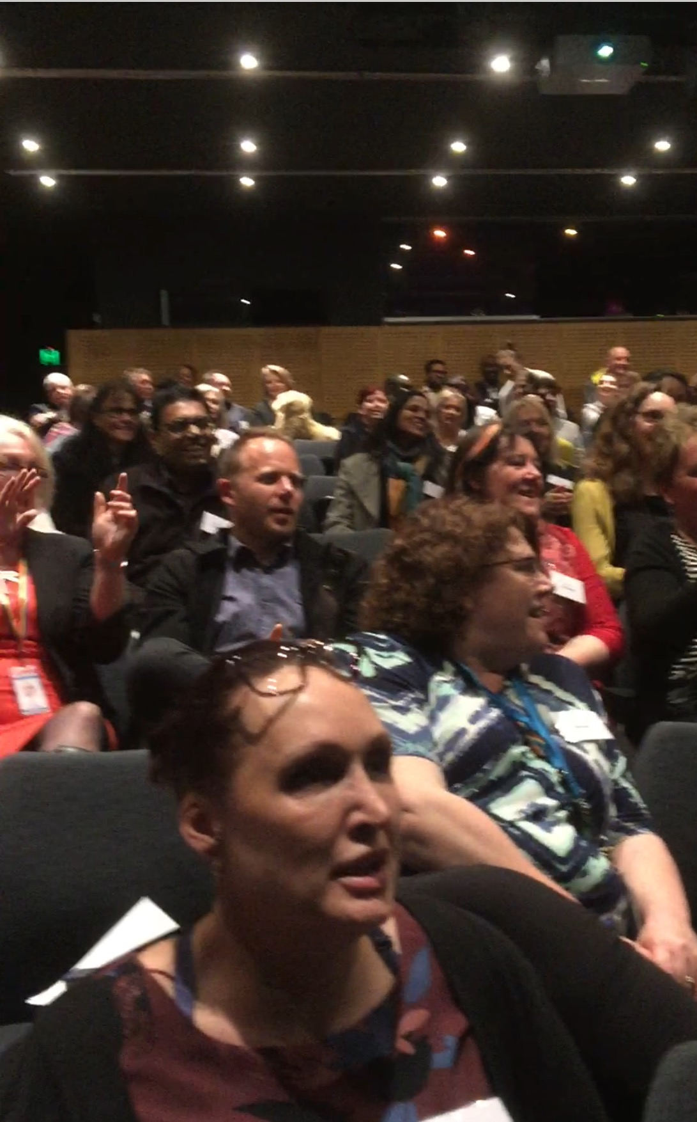
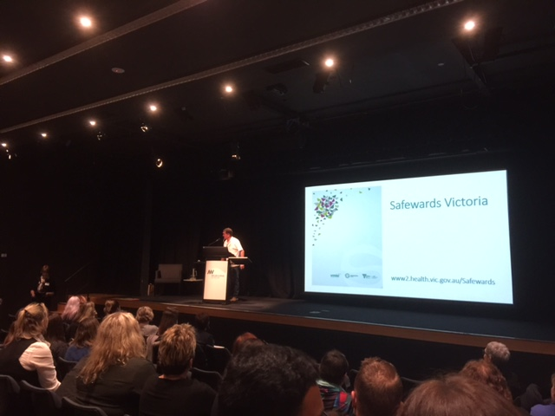
Safewards Victoria annual forum
“..I really liked that I was encouraged to think a little outside the box..”
“..This approach is contributing to culture change which benefits everyone – staff, patients and their families”.
Notes:
Marisol
The collaboration this year has culminated in A Celebration and giving back of the work that the Collaborative have achieved
Attended by 200 delegates
The theme for this year was Creating therapeutic Environments, with presentations ranging from the Safewards team to design and oxygenation (which included loud and roudy singing!)

Slide 18
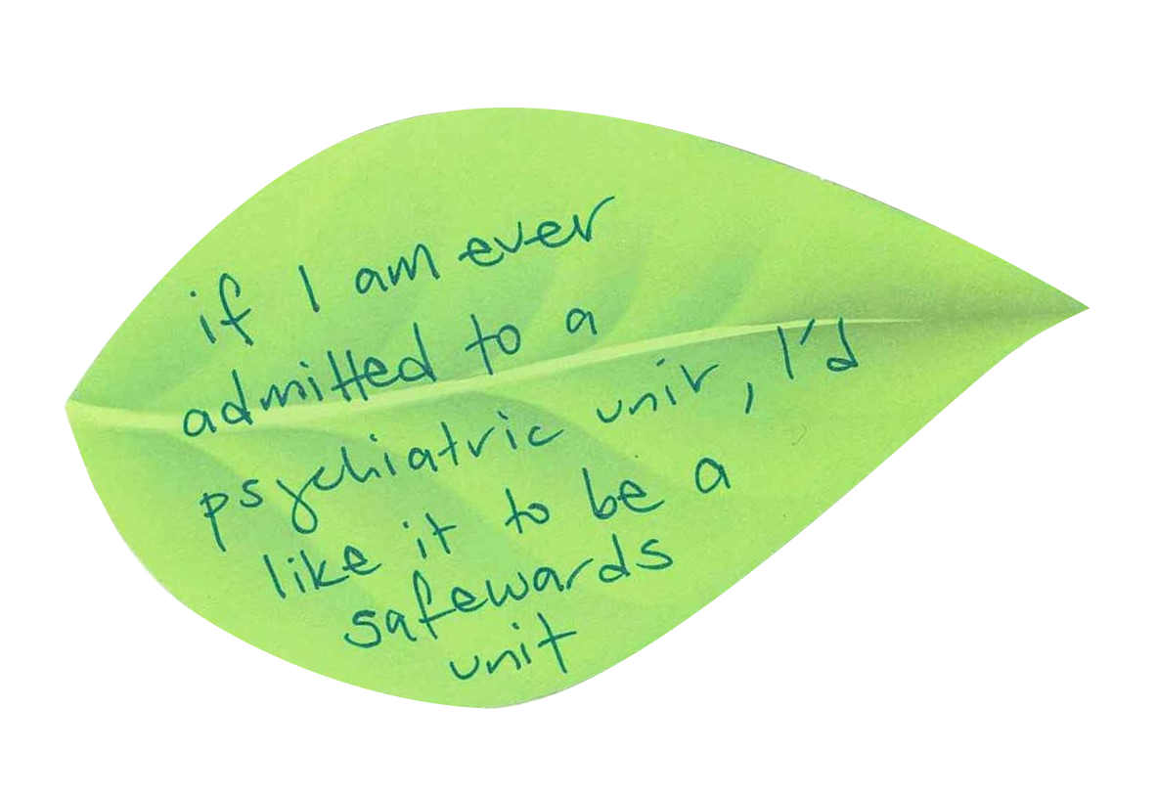

Slide 19
For more information
Thank you
www.health.vic.gov.au/safewards
www.health.vic.gov.au/mental-health/chief-mental-health-nurse
www.vmia.vic.gov.au

