Slide 1
How to Implement and Evaluate the
Child Safe Standards
RCH

Slide 2

Why do we need child safe standards?
All organisations working with children must take steps to prevent abuse. They cannot assume that child abuse does not, and cannot, happen within their organisation
The standards are a result of recommendations of the Betrayal of Trust inquiry and evidence of what works to prevent child abuse.
In 2012 and 2013 the inquiry looked into the handling of child abuse by religious and non-government organisations
Its report highlighted poor and inconsistent practices for keeping children safe. It found some organisations’ cultures did not focus on children’s safety and many failed to report or act on child abuse allegations.
Reference: Commission for Children and Young People

Slide 3

Principles
Child Safe Standards aim to:
promote the safety of children
prevent child abuse
ensure organisations and businesses have effective processes in place to respond to and report all allegations of child abuse.

Slide 4
What are the Child Safe Standards?
Department of Health and Human Services requirement that all organisations dealing with children / young people are required to meet these standards.
The standards are a set of 7 Standards to address Child Abuse:
Standard 1: | Strategies to embed and organisational culture if child safety
Standard 2: | A child safe policy or statement of commitment to child safety
Standard 3: | A code of conduct that establishes clear expectations for appropriate behaviour with children
Standard 4: | Screening, supervision, tra8ining and other human resources practices that reduce the risk of child abuse by new and existing personnel
Standard 5: | Processes for responding to and reporting suspected child abuse
Standard 6: | Strategies to identify and reduce or remove the risk of abuse
Standard 7: | Strategies to promote the participation and empowerment of children.

Slide 5
Implementation Plan
The implementation of the standards was conducted as a ‘project’ to ensure appropriate governance and accountability.
Key Concepts
Executive Sponsorship
Integration with existing clinical governance structure
Engagement of appropriate stakeholders

Slide 6

Overview of Project
The Department of Health and Human Standards require that all healthcare organisations implement the Child Safe Standards from Jan 2016.
The RCH is therefore required to demonstrate a commitment to the implementation of the standards.
There is no ‘prescribed’ timeframe for implementation of the standards
The RCH has committed to have these implemented by June 2017

Slide 7
Concept
The concept of this project was presented to the Executive Director, Nursing and Allied Health Services’ and Executive Director, Strategy and Organisational Improvement.
The project is to implement all seven Child Safe standards into the ‘usual business’ of the Royal Children’s Hospital.

Slide 8
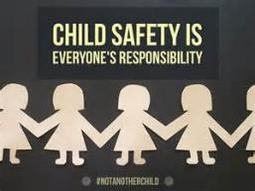
Project Scope Management Plan
System are implemented to ensure that the Child Safe Standards can be met and are sustainable
All staff are required to be aware of the requirements of the standards.
All new staff are to be made aware of the Royal Children’s Commitment to Child Safety
All potential employees will be required to demonstrate compliance with Child Safety regulations e.g. Working with Children Checks etc.

Slide 9
Project Stakeholders
Person | Role
Director Human Resources | Amendments to Code of Conduct and related Policies. Changes to recruiting practice
Manager Social Work | Review of hospital procedures and practices for reporting child abuse
Vulnerable Children's Committee (reps – medical, nursing, social work) Technical experts | ‘Owner’ of the decisions about changes to staff behaviours and practices to implement standards Overview of implementation
Director Education Institute | Alignment with requirements from Education Dept
Director Nursing Education | Incorporate requirements into education packages
Director Medical Education | Incorporate requirements into education packages
Director Organisational Development | Incorporate requirements into education packages
Director Communications | Advise and deliver internal and external communications

Slide 10

Practical Implementation

Slide 11
Where to start?
The Commission for Children and Young People
Child Safety review and action checklist
Commission for Children and Young People

Slide 12
Key Aspects of Implementation
Standard 1: Strategies to embed an organisational culture of child safety,
through effective leadership arrangements
Requirement | Action
Governance Arrangement | Embedded into ‘project’ to implement into the Vulnerable Children’s Committee – renamed to Vulnerable Children and Child Safety Committee
Modeled by Leadership | Executive Sponsor; organizational policies (endorsed by Board)
All children accepted and acknowledgement of vulnerability | Vulnerable Children policies and associate procedures
Raise awareness of Child Safety | All staff training package
Accept Diversity | Access procedures and cultural diversity committee

Slide 13
Key Aspects of Implementation
Standard 2: A Child Safety Policy or Statement of Commitment to Child Safety
Requirement | Action
Statement of commitment to child safety | Statement on webpage – RCH Commitment to child safety
Child Safety policy | Included the Child Safe Standards in the Policy – ‘Vulnerable Children and Child Safety’
Regular child safety reviews | Cases of child abuse are recorded in VHIMS Incident review process is initiated All cases in VHIMS are reported to the Vulnerable Children and Child Safety Committee to allow for trend analysis and mitigation strategies.

Slide 14
RCH Commitment to Child Safety
The RCH considers any form of child/young person abuse, inclusive of emotional, sexual abuse or neglect as intolerable.
The RCH works with vulnerable children and young people who are at risk of some form or another of abuse and therefore the RCH has a legal, ethical and moral obligations to protect children/ young people from harm and to ensure that any incident or suspected child abuse are promptly and appropriately addressed.
The RCH has a commitment to child safety on the website. RCH Commitment to Child Safety

Slide 15
Key Aspects of Implementation
Standard 3: A Code of Conduct that establishes clear expectations for
appropriate behaviour with children
Requirement | Action
Code of Conduct | Existing code of conduct was revised to include specific wording around expectations for child safety.
Training | The social workers are the key contact people for child safety (child safety officers). Provided with regular training. Roll out of training package to help staff identify ‘child abuse’.
Robust staff performance management | Systems in place for management of staff who fail to adhere to the RCH Code of Conduct or any other policies / procedures

Slide 16
Key Aspects of Implementation
Standard 4: Screening, supervision, training and other human resource
practices that reduce the risk of child abuse by new and existing personnel
Requirement | Action
Safety screening | All staff, students, volunteers required to have a working with children check and police check
Referee checks | Implemented a question in the referee check questionnaire –’are you aware on any allegations related to child safety?’ – Yes / No/ Can’t say
Advertisements and Position Descriptions | All advertisements and position descriptions point to the commitment to child safety.

Slide 17
Key Aspects of Implementation
Standard 5: Processes for responding to and reporting suspected child abuse
Requirement | Action
Reporting and responding to suspected child abuse | All staff, students, volunteers required to have a working with children check and police check
Complaints system | Existing complaints system. Specials process (flow chart) to quickly escalate any reports of child abuse
Child friendly system for kids to report when they don’t feel safe | Videos on public area AV screens: Rights of the Child and Young Person in Healthcare

Slide 18
Key Aspects of Implementation
Standard 6: Strategies to identify and reduce or remove risks of child abuse
Requirement | Action
Risk strategy | Risk are identified e.g. line of sight for patient rooms, glass fronted play rooms, procedures for chaperoning or intimate examinations.
Review of Risk Strategies | Risk register sits with the Vulnerable Children and Child Safety Committee. New risk are identified and mitigation strategies are implemented through this committee
Inclusion of Aboriginal and Torres Straight Islander (ATSI) people | The RCH has a team called WADJA who are the key contact people for ATSI. All ATSI patients are identified with a flag in the EMR. This group advise on cultural issues.

Slide 19
Key Aspects of Implementation
Standard 7:Strategies to promote the participation and empowerment of children
Requirement | Action
Participation and Empowerment | Videos on public area AV screens: Rights of the Child and Young Person in Healthcare
Rights of the Child Videos

Slide 20

Staff Training Package

Slide 21
Purpose of Training
All staff are aware of the Child Safe Standards
Provide definitions for understanding of Child / Young Person abuse
Practical guidance on processes to manage reports of child/young person abuse

Slide 22
Practical Implementation at RCH
At RCH we take our responsibility to ensure children’s safety seriously
The RCH has zero tolerance of breaches to any child / young person’s safety.
If you suspect any breaches of child safety by staff/ volunteers or the public – you have an obligation to report it to your manager.

Slide 23
Who’s responsibility is Child Safety
Role | Responsibility
RCH Board | Ensure appropriate policies and procedures are in place to minimise the risk of child abuse and appropriately respond to any allegations of child abuse.
RCH Executive | Ensure that adequate systems and resources are provided operationalise the policies and procedures and lead a culture of child safety
Managers | Comply with the relevant policies and procedures to safeguard children and young people and understand their obligations for complying and implementing the polices and procedures at the local level.
Staff | Comply with the requirements of the code of conduct and other procedures related to child safety. Advocate and promote the rights of children and young people.

Slide 24
What is Child Abuse?
Child abuse is an act by parents or caregivers which endangers a child or young person's physical or emotional health or development. Child abuse can be a single incident, but usually takes place over time.
In Victoria, under the Children Youth and Families Act 2005 a child or young person is a person under seventeen years of age or up to the age of eighteen if subject to a child protection order.

Slide 25
Types of Abuse
Sexual abuse
Physical abuse
Significant emotional and psychological abuse
Serious neglect
Grooming
Family Violence

Slide 26
Physical abuse
Physical abuse is any non-accidental infliction of physical violence on a child/young person by any person.
Examples include:
  Beating
  Shaking
  Burning
  Assault

Slide 27
Sexual Abuse
Sexual abuse is when a person uses power or authority over a child/young person to involve them in sexual activity
It can include a wide range of sexual activity including fondling the child/young person’s genitalis, oral sex, vaginal or penile penetration by a penis, finger or other object, or exposure of the child / young person to pornography disclosed by the child/ young person or family member.

Slide 28
Emotional Abuse
Emotional Abuse occurs when a child/young person is repeatedly rejected, isolated or frightened by threats or by witnessing family violence.
It also includes hostility, derogatory name-calling and put-downs, and persistent coldness from a person, to the extent that a child/young person suffers or is likely to suffer, emotional or psychological harm to their physical or developmental health.
Emotional abuse may occur with or without other forms of abuse.

Slide 29
Neglect
Neglect is the failure to provide the child/young person with the basic necessities of life such as food, clothing, shelter, medical attention or supervision, to the extent that the child's health and development is, or is likely to be, significantly harmed.
In some circumstances the neglect of a child:
Can place the child / young person’s immediate safety and development at serious risk
May not immediately compromise he safety of the child, but is likely to result in longer term cumulative harm

Slide 30
Grooming
Grooming is when a person engages in predatory conduct to prepare a child/young person for sexual activity at a later time. Grooming can include communicating and/or attempting to befriend or establish a relationship or other emotional connection with the child/young person or their parent/carer.
Examples of grooming may include:
Giving gifts or special attention to a child/young person or their parent/carer (this can make a child feel special or indebted to an adult)
Controlling a child through threat, force or use of authority (this can make a child fearful to report unwanted behaviours)
Making close physical contact sexual, such as inappropriate tickling or wrestling
Openly or pretending to accidently expose the victim to nudity, sexual material and sexual acts
Use of social media to attract a child/young person (on-line grooming)

Slide 31
Family Violence
Family violence is behaviour by a person towards a family member of that person that:
  is physically or sexually abusive
  is emotionally or psychologically abusive
  is economically abusive
  is threatening
  is coercive
  in any other way controls or dominates the family member and causes that family member to feel fear for the safety or wellbeing of that family member or another person.
  and/or behaviour by a person that causes a child to hear or witness, or otherwise be exposed to the effects of, the above behaviour.
  Refer to the Strengthening Hospitals Response to Family Violence Project

Slide 32
Practical Implementation at RCH
Code of Conduct
The RCH has a Code of Conduct in which staff, volunteers and students are to adhere to.
Employment Safety Screening
The Human Resources and Volunteers departments have systems in place to ensure safety screening of all potential employees, volunteers and students:
police checks,
working with children checks,
referee checks (specific questions about alleged child safety issues)

Slide 33
Practical Implementation at RCH
Processes for Responding to and reporting child/young person abuse
Vulnerable Children procedures on Policy and Procedure Manual
Strategies to promote the participation and empowerment of young people and children
Videos screening on screens in public areas (Rights of the Child and Young people in healthcare) and messages to say it is ‘OK” to talk to staff

Slide 34
Vulnerable Children
Policy and Procedures
Policy
Vulnerable Children and Child Safety
Procedures:
Vulnerable Children - Children on Interim Accommodation Orders placed in the care of the RCH.
Vulnerable Children - Management of Known Sex Offenders at RCH
Vulnerable Children - Procedure for Referral between VFPMS and Gatehouse
Vulnerable Children - RCH Procedure for Suspected Child Abuse
Vulnerable Children - Responding to Intervention Orders at RCH
Family violence: Responding to patients
Chaperones for Intimate Examinations

Slide 35
What do I do if I suspect child abuse?
Do you consider the baby, child or young person has been, or is likely to be, harmed by abuse or neglect?
Staff/ Volunteer/ Student
Family Member
Member of the Public
Advise Manger Immediately
Advise Manager / Social work immediately
Advise Manager Immediately
Work with Strategy & Improvement Quality Managers
Follow Vulnerable Children’s Procedure
Follow Vulnerable Children’s Procedure
Complete an incident report (VHIMS)

Slide 36
Procedure for Suspected Child Abuse
The clinical staff have a education packages on how to manage cases of child abuse as well as a moral obligation to disclose any suspicion of child abuse to relevant authorities.
Refer to craft group specific education packages.
Notes:
This is a detailed procedure that all RCH staff should adhere to.
This procedure is not discussed in detail during this orientation session however we want you to know that it is a very important procedure that you must read in full by the end of the week and have provided you a paper copy of the procedure as a handout including the flowchart of steps for responding to suspected child abuse.
If you only remember one procedure today, remember this one.

Slide 37
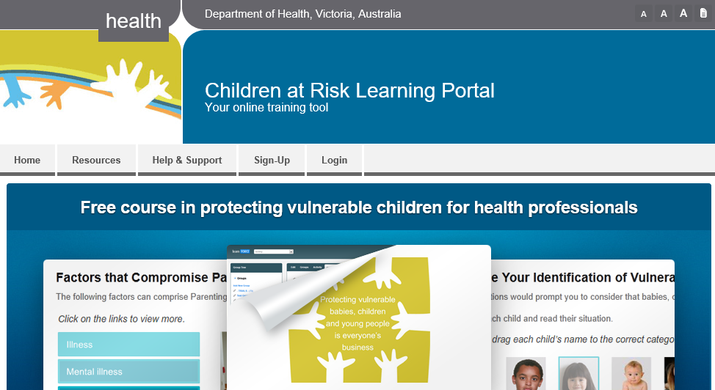
E-learning tool
http://vulnerablechildren.e3learning.com.au/
Notes:
You may wish to use this tool to practice your decision making after orientation.
Encourage all nurses present to do this e-learning tool in order to practice decision making regarding reporting to Child Protection and referral to Child FIRST. Remind the nurses that RCH expects nurses to discuss with senior managers and SW (with possible discussion with VFPMS) as a first step rather than reporting to Child Protection on the basis of mere SUSPICION but when a BELIEF is formed about the need for protection from physical abuse or sexual abuse then mandatory reporting obligations must determine action.

