Slide 1

YOUR VOICE AGAINST VIOLENCE
Notes:
Thank you
Acknowledgement of country
Peak body
Membership
Role

Slide 2
Overview
Definition
Prevalence
Impact
Determinants
Responding to family violence
Royal Commission recommendations
Resources

Slide 3
‘Behaviour by a person towards a family member of that person if that behaviour-
is physically or sexually abusive; or
is emotionally or psychologically abusive; or
is economically abusive; or
is threatening; or
is coercive; or
in any other way controls or dominates the family member and causes that family member to feel fear for the safety or wellbeing of that family member or another person;
or behaviour by a person that causes a child to hear or witness, or otherwise be exposed to the effects of, behaviour referred to [above]’
Family Violence Protection Act 2008
Notes:
DEFINING FAMILY VIOLENCE -
Historically we've had a tendency to view FV as only physical violence. And an outburst of pent up anger.
Not about anger / most men who choose to use violence able to control their behavior in the workplace
not about physical
Relationship violence does not take the form of a single incident. It is ongoing behaviour that gradually undermines the victim’s confidence and ability to leave the violent person. The severity and frequency of violence often escalate over time.
This violence takes many forms, none of which is mutually exclusive. While physical violence may be the most visible form, others such as sexual, emotional, social, spiritual and economic abuse can be equally harmful.
We use gendered language to explicitly acknowledge that the vast majority of victims of domestic violence are female and perpetrators male (Australian Bureau of statistics 2006).
This does not negate the fact that people of different genders may be either victims or perpetrators of domestic violence.
The Victoria FV protection act provies a comprehensive definition that encompasses the range of behaviours
Because its experienced as a range of abuse behaviours
A pattern
However it is rarely experienced as just physical violence and sometimes women can experience terrifying abuse with long term negative health outcomes without ever experiencing physical assault.
May involve abuse of pets
One physical assault may hang as a reminder of consequences
Women usually experience it as a range of behaviours all designed to intimidate, terrify and control.
POST SEPARATION VIOLENCE - Escalalation of violence

Slide 4
34%
Percentage of Australian women 35-40 who have experienced family violence
- Research Study 2016

Slide 5
Prevalence
A woman is murdered on average every week in Australia due to family violence
One in three women are subjected to intimate partner violence in their lifetime and
One in five women have experienced sexual assault.
More than half of the women who experienced violence had children in their care when the violence occurred.
Notes:
A woman is hospitalised every 3 hours in Australia as a result of family violence
3 women are hospitalised every week as a result of brain injury caused by family violence
There is growing evidence that women with a disability are more likely to experience violence. For example, 90% of Australian women with an intellectual disability have been subjected to sexual abuse.⁸
Indigenous women experience disproportionately high levels of family violence.⁹

Slide 6
Intimate
Partner
Violence
Contributes an estimated 5.1% to the disease burden in Australian women aged 18-44 years which is higher than any other risk factor including tobacco use, high cholesterol or use of illicit drugs.
ANROWS 2016
Notes:
Driver of homelessness
Over 60% substantiated child protection cases
Costs the Australian economy 21.7 billion per year

Slide 7
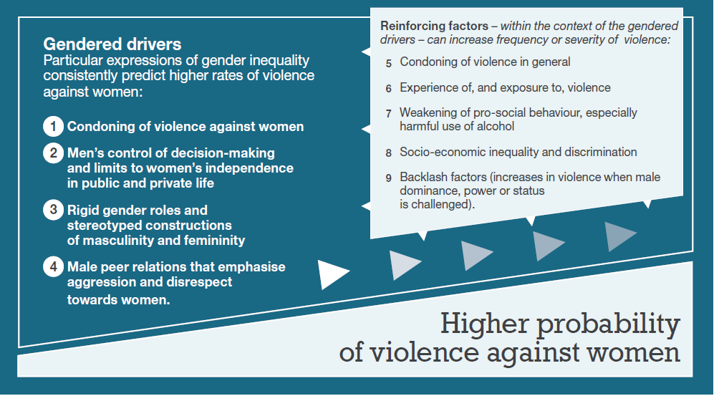
Notes:
Family violence is gendered -
Family
women and children are usually victims and perpetrators are most often men.
95% of victims of violent crime in Australia - whether they are male or female - experienced the abuse from a male perp
DETERMINANTS
Historically, many attempts to understand violence against women have sought simplistic or single-factor causes for individual men’s violence. Such explanations point to the psychology or mental health of the perpetrator, his life experiences (such as childhood exposure to violence), behaviour (such as alcohol use) or personal circumstances (such as unemployment). While such individual level factors may well be relevant, we need to explain why most men to whom they apply are not violent, and why other men not exposed to any of these factors are violent. We also need to explain why such factors seem relevant in some cases, contexts or countries, but not others.
There is now international
research that examining the way in which gender relations are structured is key to understanding violence against women. Studies by the United Nations, European Commission, World Bank and World Health Organization all locate the underlying cause or necessary conditions for violence against women in the social context of gender inequality.36
The Our Watch framework for the primary prevention of VAW cites the main drivers of gender inequality as being:
1 Condoning of violence against women
2 Men’s control of decision-making and limits to women's independence
4 male peer relations that emphasize aggression and disrespect towards women.
3 Rigid gender roles and identities
Obviously you're all aware that the term gender refers not to the physiological differences between women and men but about how we socially construct what it means to be a woman or a man
In the research on perpetration, There is a strong association between adherence to to traditional gender roles /norms, violence supportive attitudes and the perpetration of VAW

Slide 8
Attitudes Snapshot
43% agreed that rape results from men not being able to control their need for sex
1 in 5 agreed that a woman is partly responsible for rape if she is intoxicated
1 in 5 men believe that men should be head of the household
Men make better political leaders
National Community Attitudes Survey

Slide 9
What can health professionals do?
Look for signs
Ask the question
Validate
Provide a reality check
Ensure personal agency
Provide support within the context of their own professional role
Comprehensively refer
Themes from lay witnesses - Royal Commission
Notes:
RC said
Health care professionals are in a key position to identify and respond - many women experiencing FV will not even contemplate contacting a FV service but may reach out to a health care worker particularly at times of heightened risk i.e. During Pregnancy or following childbirth
Or seek treatment for injuries or medical conditions arising from FV
Failing to identify signs of FV or minimizing disclosures can have a devastating impact and can deter victims from seeking support in the future
A range of health services come into contact with those experiencing FV including GPS, maternal and child health services, hospitals
There are many reasons for health professionals failing to inquire - lack of training, anxiety re what to do then, lack of referral options, limited time
Lots of examples where FV is recognized as a necessary response -
Collocation of services i.e. Health and legal
While there's pockets of good practice the RC found a lack of cohesiion and consistency in the way in which FV is responded to. There is no healthwide system approach.
I’ll speak to what is required for a more systematic approach in a minute but first I want to speak about what you can do individually as a health practitioner
The role of health professionals in responding to violence against women
is critical. There were noteworthy themes from the lay witnesses that presented at the Royal commussion into family violence in Victoria this year of the differences that
They looked for signs
They asked the question
They validated her experience
They provided a reality check
Ensured the woman's agency
Provided support within the context of their own role
They comprehensively referred
2. ASK RHE QUESTION
many professionals can be terrified to ask the question bc they don't know what to do which is fair enough
MKe an excuse to get her on her own - Ask her on her own
Don't breach confidentiality or speak with abuser
Screening assessment and protcols - Many hospitals are now introducing Screening and assessment protocols - which are great but what is important to recognise is that this isn't the same as
Screening can be conceptualise FV as a disease rather than a social problem. So screening can be understood as just asking a question which may result in disclosures but not necessarily ensure safety of women or quality of care
3.They validated her experiences
Nobody will believe you
Women don't recognise they're in an abusive relationship
He's not physically violenct
Blames her
Mad or bad
Validate her experimece
Everyone has the right to feel safe
There's never an excuse for violence or abuse
Ensured the woman's agency
Don't take over or make choices on her behalf
There are good reasons why women don't leave
Provided support within the context of their own role
Do you want me to write a report for you
Prioritised her safety

Slide 10
Looking for signs
Physical injuries
Pregnancy
Protectiveness from a partner may be a screen for attempts to limit her ability to disclose
Risk factors beyond gender
Notes:
This is a time when women are the most dependent on their partner – financially, practically, emotionally – less easy for them to leave
Power imbalance
Looking for signs
Obviously physical indicators
Given the statistics that 1 in 3 women will experience physical abuse from a partner, I think you can assume that many women you are treating will be experiencing family violence
Pregnancy itself is a recognized Risk factor
According to the 2012 ABS Personal Safety Survey, 36% of women over the age of 18 have experienced physical or sexual violence by a known perp since the age of 15.
Of those women, 22% experienced physical violence during pregnancy by a current partner and 25% during pregnancy from a previous partner.
Of those who had experienced violence during pregnancy by a previous partner, 25% indicated that the violence first occurred during pregnancy.
Men who choose to use violence will take opportunities to exert dominance
Any man who is willing to physically harm a woman while she is pregnant is a danger
Is he her constant shadow
Does he cast doubt on her mental stability
ISOLATION
🍉🍉🍉🍉
There is a strong correlation in the research about termination of pregnancies and family violence
Reproduction control, coercion and sexual assault by an abusive partner may result in unintended pregnancies and forced termination of pregnancy.
Is she Furtive re Contraception
They comprehensively referred
1800 Respect
Referral Protocols with local services

Slide 11
What can health professionals do?
Look for signs
Ask the question
Validate
Provide a reality check
Ensure personal agency
Provide support within the context of their own professional role
Comprehensively refer
Themes from lay witnesses - Royal Commission
Notes:
RC said
Health care professionals are in a key position to identify and respond - many women experiencing FV will not even contemplate contacting a FV service but may reach out to a health care worker particularly at times of heightened risk i.e. During Pregnancy or following childbirth
Or seek treatment for injuries or medical conditions arising from FV
Failing to identify signs of FV or minimizing disclosures can have a devastating impact and can deter victims from seeking support in the future
A range of health services come into contact with those experiencing FV including GPS, maternal and child health services, hospitals
There are many reasons for health professionals failing to inquire - lack of training, anxiety re what to do then, lack of referral options, limited time
Lots of examples where FV is recognized as a necessary response -
Collocation of services i.e. Health and legal
While there's pockets of good practice the RC found a lack of cohesiion and consistency in the way in which FV is responded to. There is no healthwide system approach.
I’ll speak to what is required for a more systematic approach in a minute but first I want to speak about what you can do individually as a health practitioner
The role of health professionals in responding to violence against women
is critical. There were noteworthy themes from the lay witnesses that presented at the Royal commussion into family violence in Victoria this year of the differences that
They looked for signs
They asked the question
They validated her experience
They provided a reality check
Ensured the woman's agency
Provided support within the context of their own role
They comprehensively referred
2. ASK RHE QUESTION
many professionals can be terrified to ask the question bc they don't know what to do which is fair enough
MKe an excuse to get her on her own - Ask her on her own
Don't breach confidentiality or speak with abuser
Screening assessment and protcols - Many hospitals are now introducing Screening and assessment protocols - which are great but what is important to recognise is that this isn't the same as
Screening can be conceptualise FV as a disease rather than a social problem. So screening can be understood as just asking a question which may result in disclosures but not necessarily ensure safety of women or quality of care
3.They validated her experiences
Nobody will believe you
Women don't recognise they're in an abusive relationship
He's not physically violenct
Blames her
Mad or bad
Validate her experimece
Everyone has the right to feel safe
There's never an excuse for violence or abuse
Ensured the woman's agency
Don't take over or make choices on her behalf
There are good reasons why women don't leave
Provided support within the context of their own role
Do you want me to write a report for you
Prioritised her safety

Slide 12
Perpetrator history of violent behaviour both within and outside the household
Access to lethal weapons
Perpetrator use of alcohol and drugs
Recent separation or divorce
Perpetrator stressors such as unemployment
Perpetrator history of witnessing violence
Evidence of mental health problems in perpetrator
Perpetrator resistance to change
Attitudes of perpetrator that supports violence against women
Risk Indicators

Slide 13
Responding to disclosures from men who choose to use violence
Physical injuries
Take a history
Condemn the actions, not the person
Encourage ownership
Make appropriate referrals
Avoid collusion

Slide 14
Recommendation 3
The Victorian government implement the revised Family Violence Risk Assessment and Risk Management Framework and develop a sustained workforce development and training strategy as part of the recommended FV Industry Plan
Royal Commission into Family Violence

Slide 15
Recommendation 95
The Victorian Government resource public hospitals to implement a whole-of-hospital model for responding to family violence, drawing on evaluated approaches in Victoria and elsewhere [within three to five years].
Royal Commission into Family Violence

Slide 16
Recommendation 96
The Department of Health and Human Services require routine screening for family violence in all public antenatal settings. The screening guidance should be aligned with the revised Family Violence Risk Assessment and Risk Management Framework. Implementation will require targeted and continued training, the development of specific guidelines, and clinical support
[by 31 December 2017].

Slide 17
Recommendation
102
The Chief psychiatrist – in consultation with the Royal Australian College of General Practitioners, the Royal Australian and New Zealand College of Psychiatrists and psychologists’ peak bodies - coordinate the development of a family violence learning agenda that includes undergraduate and graduate training and continuing professional development

Slide 18
Recommendation 103
The Victorian government through its membership of the Australian Health Workforce Ministerial Council, encourage the Council to approve standards that facilitate a mandatory requirement that general practitioners complete family violence training
Royal Commission into Family Violence

Slide 19
Recommendation
207
The Victorian Government develop or commission the development of a 10 year industry plan for family violence prevention and response in Victoria, to be delivered by 31 December 2017 with commensurate funding for workforce transition
Royal Commission into Family Violence

Slide 20
Resources
Strengthening Hospital Responses to Family Violence toolkit – The Women’s
Royal Australian College of General Practitioners Clinical guidelines
Child Family Community Australia practitioner guidelines
ANROWs
Our Watch
Royal Commission into Family Violence report

Slide 21
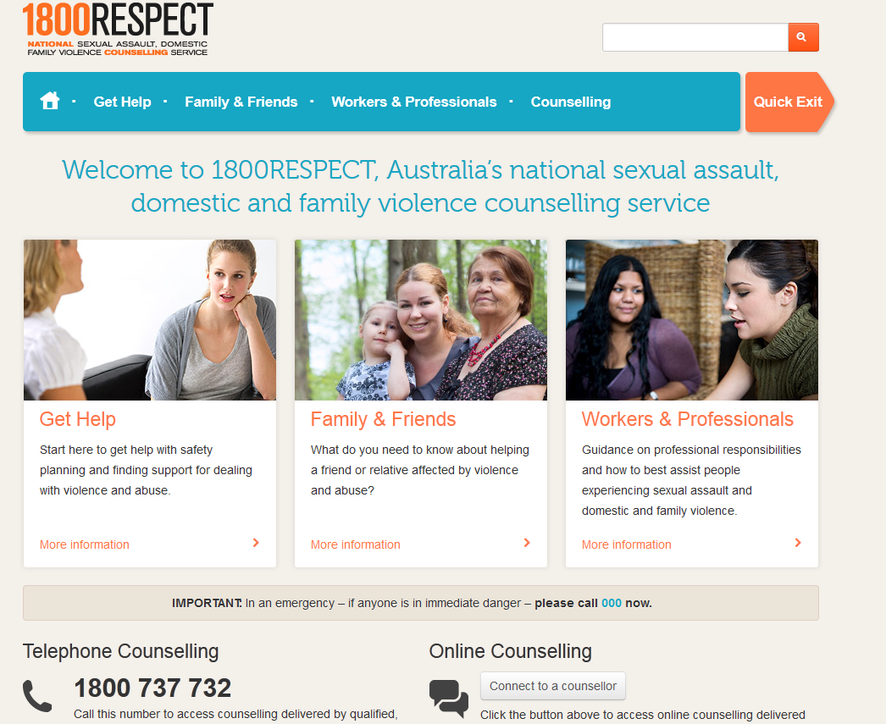
Notes:
The 1800 RESPECT website has been recently established to support victims of family violence & sexual assault.
There is also a page (on the right) for workers and professionals.
We would encourage you to visit this website – includes info:
Find answers to common questions about supporting clients or patients affected by domestic and family violence and sexual assault (from their FAQ page)
How do I assess the risk of violence faced by clients or patients?
How can I support a co-worker or employee?
Where can I find workplace resources for DFV and sexual assault?
What is domestic and family violence?
What is sexual assault?
How can a protection order help to stop the violence?
How can I find counselling services for DFV & sexual assault?
How can I get help for a child or young person affected by violence?
How do I find Indigenous services?
How does domestic and family violence affect children?

Slide 22
Thank you
Join the Voice Against Violence at www.dvvic.org.au

