Slide 1


Notes:
Who’s seen the campaign ads on TV?

Slide 2
Occupational Violence and Aggression –
Barwon Health’s approach.
James Tamblyn
Director Workforce Safety
Barwon Health

Slide 3
Overview
What is OVA?
The impacts of OVA
The prevalence of OVA at Barwon Health
What is being done about OVA?

Slide 4

Barwon Health – a snapshot
Approximately 7000 employees
Primary catchment: approximately 350,000 people
Over 30 sites
Over 1000 inpatient beds
Full spectrum of health services:
  Emergency
  Acute and Mental Health
  Community Health
  Sub-Acute / Rehabilitation
  Aged Care
Notes:
To help provide some context around Barwon Health as an organisation

Slide 5
Defining OVA
Any incident where an employee is abused, threatened or assaulted in circumstances arising out of, or in the course of their employment.
Notes:
This definition comes from the Department of Health and Human Services’ Preventing occupational violence: A policy framework including principles for managing weapons in Victorian health services (2011).
So, what types of things are we talking about here….

Slide 6
OVA can take many forms
Threats
Spitting
Scratching
Pulling hair
Yelling
Sexual assault
Biting
Kicking
Punching
Notes:
Most of us understand that extreme acts of violence are unacceptable.
But OVA can take a range of forms: verbal or psychological abuse, aggressive gestures, yelling, swearing and threats….. All the way through to spitting, biting, scratching, punching, kicking, throwing objects, and sexual harassment.
Importantly, it’s worth noting that impacts and injuries to staff can result from exposure to a single incident; or a cumulative effect due to exposure to multiple incidents over a sustained period of time.

Slide 7
Anyone has the potential to become aggressive or violent
Elderly people
Families
Children
People with dementia
People with mental health conditions
People with delirium
People who are in pain
People with alcohol and other drug issues
Notes:
OVA can be perpetrated by any of our patients, residents or visitors. And in any of our health care settings including the home based setting.
It’s important to note that just because a patient or resident is old and frail, it doesn’t mean they can’t initiate OVA. In fact one of Barwon Health’s most significant OVA injuries this year occurred in one of our aged care facility, where a staff member was pushed by a resident, resulting in fractured ribs and a significant amount of time off work.
The perception that violence and aggression is mainly perpetrated by young adults affected by drugs or alcohol is simply untrue.
Usually there is a reason for occupational violence and aggression – a combination of personal, environmental or situational factors generally play a part. Sometimes, someone isn’t aware of what they are doing or doesn’t intend to cause any harm. But that’s not the point, because it still can impact on the health & safety of our staff, and we need to make sure we have preventative strategies in place for these situations.
Fundamentally everyone has the right to feel safe at work.

Slide 8

The impacts of OVA
Employee:
-Physical
  -Psychological
  Organisational:
  -Financial
  -Compliance
  -Reputational
Notes:
Fractured ribs, broken noses, bruises and scratches.
Psych – employees who cannot return to their jobs due to stress and anxiety caused.
8 standard WorkCover claims in 16/17 financial year – costing hundreds of thousands of dollars in WorkCover premium. One will most likely cost in excess of $700K in real premium expenses over the course of the three year premium sensitive period of that claim.
Reputational / public image: Bad press earlier in year on Channel 7 and newspapers.
Dr Patrick Pritzwald-Stegman – punched 30th May after asking a hospital visitor to not smoke outside the hospital entrance, died a month later.
41 years old, husband and father of two.

Slide 9
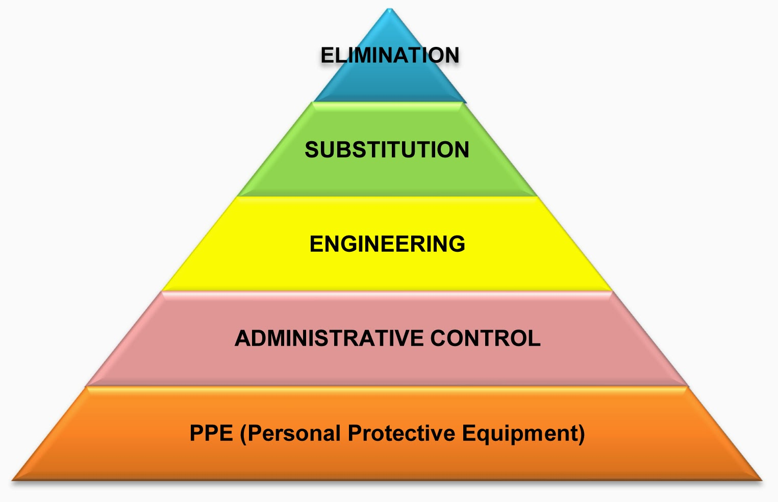
OVA – hierarchy of control?
Notes:
-Do people think OVA as a hazard can be eliminated?
-Human behaviour. Can’t ELIMINATE! Pretty hard to substitute too!
-Not bringing a WAH job down to ground level. Not applying a guard to a machine.
-Public hospitals are an extension of the public street! Can’t turn people around like a private hospital or even a pub. We are required to treat all people who attend our emergency department. This includes those who may be affected by drugs or alcohol or who are mentally unwell.
-Controls have often focussed on admin controls – staff training in de-escalation and basic breakaway techniques, Code Grey procedures, warning signage, security, behavioural management plans for high risk patients.
-Engineering controls and environmental design are fortunately now a strong focus as well and DHHS are investing heavily in hospitals improving in this space at the moment:
-Room layout, eg: second exit as an escape point in all rooms
-Staff safe zones or retreat zones
-Protective perspex barriers at reception counters
-Behavioural Assessment Rooms in ED’s to isolate patients with behaviours of concern from others.
-Reducing agitating stimuli (hot/cold; noise; stark light) – eg our ED.
-Availability of potential weapons – eg: curtain rails being used as weapons, medical equipment lying on trolleys, anti-ligature design particularly in Mental Health facilities.
-Duress alarm systems
-Door security

Slide 10
Code Grey
Unarmed Personal Threat
A personal threat where the aggressor is unarmed, including aggressive behaviour where any person (patient, visitor, intruder or staff) threatens injury to others or themselves.
Code BLACK
Armed Personal Threat
A personal threat from a person who is armed with any form of weapon.
Notes:
Can someone tell me what Code Grey is?
X6 Code Blacks in 2016 at Barwon Health – mostly knives found on patients.
Other examples are a stapler in ED being brandished as a weapon.

Slide 11

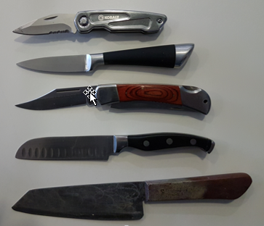

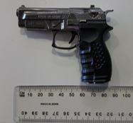
Confiscated weapons

Slide 12
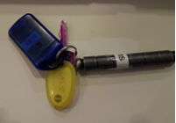
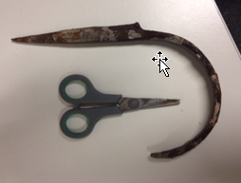
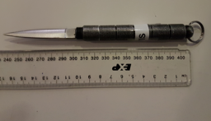
Confiscated weapons
Notes:
Another example recently, Code Black not called. Petrol doused patient with cigarette lighter in ED Waiting room.

Slide 13
Code Grey by month
Notes:
This slide gives an idea of the prevalence of OVA at Barwon Health.
On average about 100 per month at the hospital, and mostly at ED. Approx 3-4 / day.
Incident reporting: When a Code Grey is called, it doesn’t necessarily mean an incident will be loaded, which this next graph shows.
Traditionally the health sector is good at calling Code Greys, but not so good at reporting and recording the incidents as ‘OHS incidents’ on our incident reporting system.
There is a few reasons for this…

Slide 14
Incident Reporting - challenges
Traditionally a culture of acceptance – “it’s a part of the job”
Time consuming and complex incident reporting system
Perception of no benefit in reporting
Notes:
Makes it difficult to get a true reflection of the impact of OVA at Barwon Health and how staff are affected.
A lot of our education as an OHS department is about coaching managers and employees the importance of reporting.

Slide 15
Code Grey versus OVA incidents by month
Notes:
This next graph illustrates the disparity between Code Greys and OVA incidents reported.
264 verbal and phsyical incidents between July 2016 and June 2017 versus approx. 1100 Code Grey events
Increase in July due to WorkSafe campaign and reporting method in ED – introduction of ‘old school’ paper based reporting template.

Slide 16


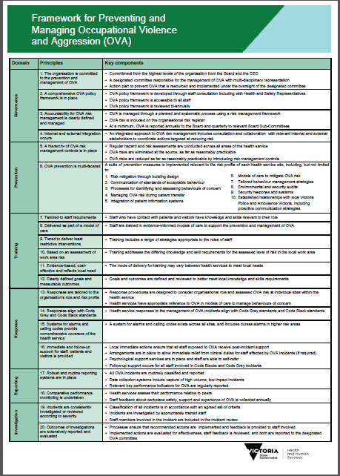
Key developments in recent years
Notes:
Growing emphasis and profile over the last few years…
Victorian Auditor General Office (VAGO) report
– Occupational Violence Against Health Care Workers – 2015: Recommendations for health services, DHHS and WorkSafe.
2015 ANMF 10 point plan – EBA requirement to comply
2017 DHHS Framework for Preventing and Managing OVA
DHHS Code Grey Standards – September 2017
DHHS funding - $40 million over a four year period from 2015

Slide 17
What Barwon Health is doing
OVA Working Group:
    comprising executive, management, HSR, unions, WorkSafe and Vic Police.
OVA Action Plan
OVA Training Program for all staff – (MOVAIT)
Code Grey and Code Black procedures
Duress alarms in high risk areas
Increased security presence in the Emergency Department
Establishment of a stronger relationship with Victoria Police
Implementation of police handover tool in the Emergency Department
OVA incident data reported to the Board and Executive
OHS input at design phase of all capital projects.
Notes:
These are some of the things we have …
-OVA WG: collaborative meeting of internal/external stakeholders
-A large part of our work has been the development of an OVA Action Plan – to address a lot of the recommendations outlined in the reports and standards I outlined a few slides back.
-We have an excellent training program available for all staff – approx. 20 years.
-We do have Code Grey and Code Black procedures – and have a designated team of specialised Code Grey responders at our hospital
-Duress alarms – present in all wards. In ED and some of our community health sites, these duress alarms link straight to the police.
-As mentioned earlier, we have recently increased our security presence at the hospital to three at all times (and two in ED).
-Vic Pol – Dedicated police liaison officer (Senior Sergeant of Geelong Station). Working closely with Geelong Police to have them involved in our OVA training as a means of further collaborating and making staff feel more comfortable to report instances of assault to police. We have had staff who have taken out restraining orders against patients.
-Police handover: weapons check in the presence of hospital staff for any patient who comes in under police custody.
-Exec and Board oversight. That’s why reporting is so important.
-Design for OVA prevention

Slide 18
What Barwon Health is doing
– coming up….
Appointment of Coordinator – OVA – Prevention & Management.
Mobile duress system for community staff.
Behavioural Assessment Room in the Emergency Department.
Review of Code Grey procedures, including the roll out of a Planned Code Grey.
Review of Barwon Health’s OVA training model (MOVAIT).
Implementation of behavioural monitoring tool (Broset Violence Checklist) in the Emergency Department.
Increased security presence at the McKellar Centre.
Improved ward lock-down during after-hours.
Notes:
-OVA role to lead a lot of the work that is coming up.
-Mobile duress: close to rolling out product which allows staff to simply hit a button when conducting home visits and this activates a two way ‘walky talky’ with a call monitoring system. Eliminated the need to make a ‘clunky’ phone call when it may not be possible.
-BAR: for patients with behaviours of concern in ED – safely segregate them from other staff and patients (successful DHHS funding bid)
-Planned Code Grey – pre-emptive response for emerging or early stage OVA
-Review of OVA training model to ensure tailored training is delivered to all staff that is role and department specific – challenging in an organisation of 7000 employees.
-Broset – for patients who have come in under police custody, MH, drug or alcohol affected. Assess and monitor behaviour in the same way that basic obs are conducted.
-24/7 security model at McKellar
-Installation of swipe access to all wards, in addition to more robust lock down procedures from the street entrances.
Just a summary of some of the initiatives within our OVA Action Plan.
Would be nice to have done this presentation in a year’s time when a lot of this will be implemented.

Slide 19

Notes:
-Complicated and challenging OHS issue to tackle, which has quickly evolved in the last few years.
-I hope this has provided an insight into the risks that our health care workers are exposed to in their daily work; but also some of the good work that is underway to protect the health and safety of health care workers.
-There is a long way to go and we have a lot of work to do to continually improve our systems, as does the whole industry.
-But in closing it is very pleasing in recent years to see the emphasis and focus that is now being placed on the prevention and management of OVA by the DHHS, hospitals themselves and WorkSafe.
-Thank you.

Slide 20
Thank you.

