Slide 1
Incident Response Program
Jo Miller, Senior project officer

Slide 2
Incident Response Team
Nathan Farrow Manager, Incident Response Team T 03 9096 5426 M 0409 552 986 E nathan.farrow@dhhs.vic.gov.au | Joanne Miller Senior Project Officer, Incident Response Team T 03 9096 5426 M 0409 552 986 E Joanne.miller@dhhs.vic.gov.au
Miranda Cornelissen Senior Project Officer, Incident Response Team T 03 9096 7330 E miranda.cornelissen@dhhs.vic.gov.au | George Braitberg Senior Medical Advisor, Incident Response Team T 03 9096 1347 M 0418 580 974 E george.braitberg@dhhs.vic.gov.au
Notes:
Who is SCV

Slide 3
Incident Response Program
Serious and Sentinel Events
Administer, advice & support, training & sharing
PEER
Provide a centralised pool of external, independent reviewers that health services can invite to participate in review
Academy
Undertake safety systems reviews and complex or inter jurisdictional serious adverse event reviews (investigations) commissioned by Safer Care Victoria
*Safety System Reviews

Slide 4
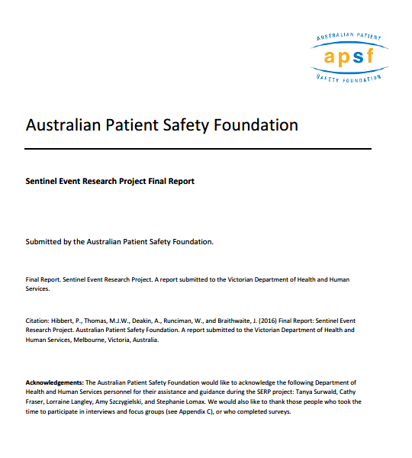
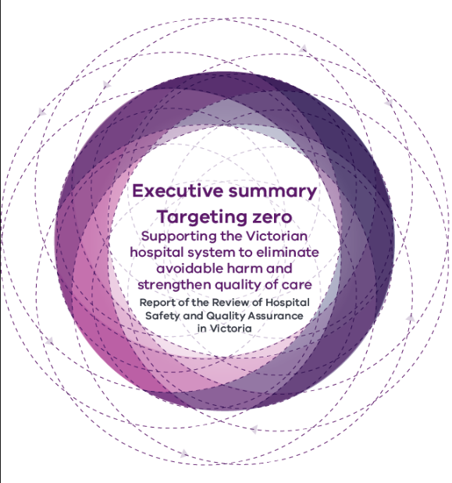
Why we do it….

Slide 5
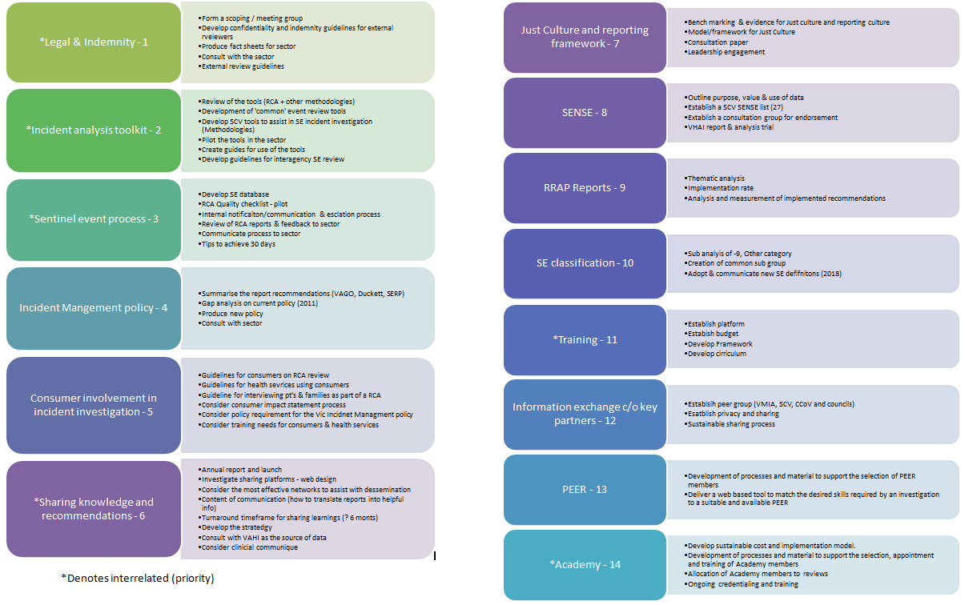
Work plan!

Slide 6
Sentinel event classification - Update
Draft list of SE categories = 10 (+1 for Victoria = 11)
Expected to be implemented 1/7/2018
*Victorian 9 – Other
NQF – National quality forum JC – Joint Commission

Slide 7
Sentinel Event - Process

Slide 8
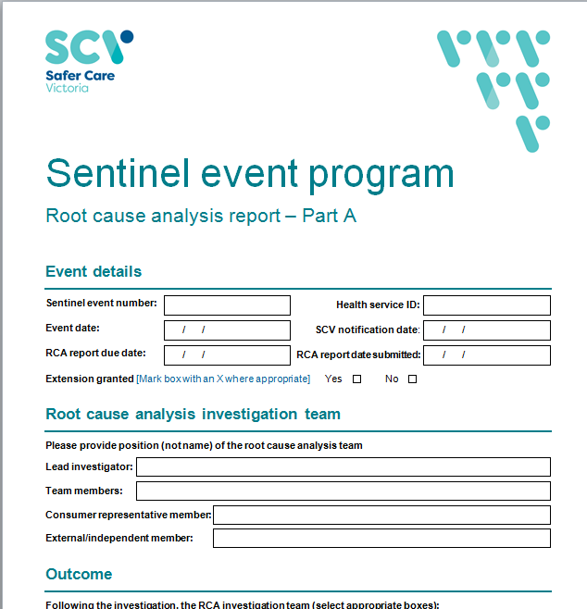
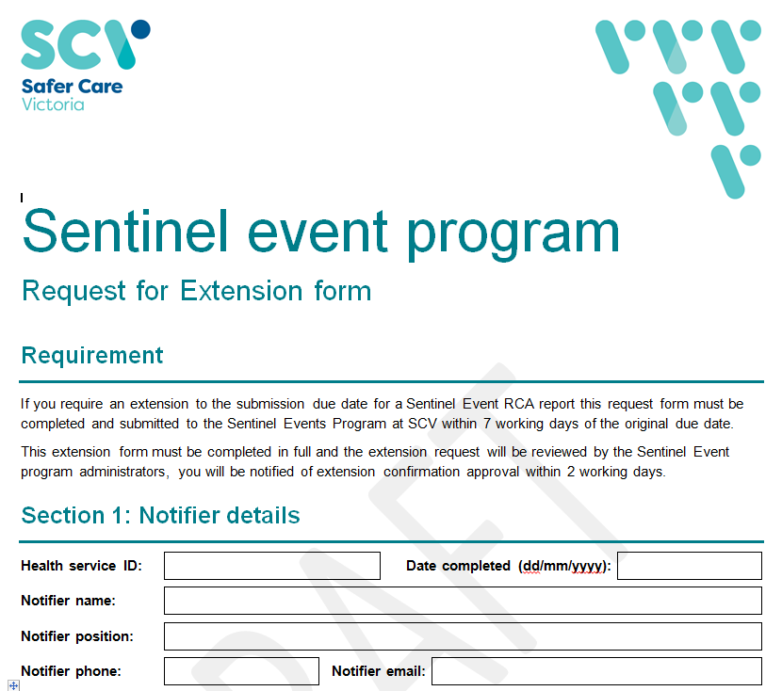
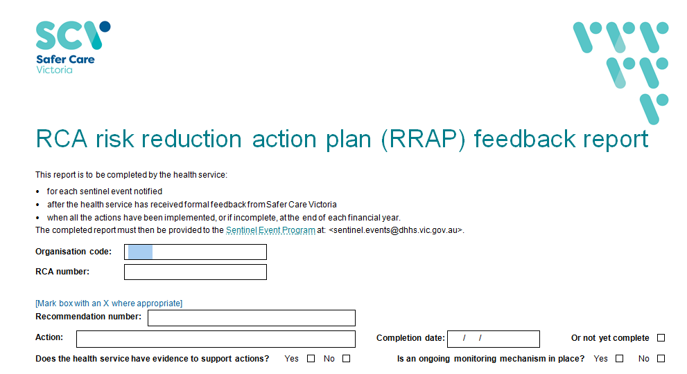

Slide 9
SE numbers
Procedures involving the wrong patient or body part resulting in death or major permanent loss of function
Suicide in an inpatient unit
Retained instruments or other material after surgery requiring re-operation or further surgical procedure
Intravascular gas embolism resulting in death or neurological damage
Haemolytic blood transfusion reaction resulting from ABO incompatibility
Medication error leading to the death of a patient reasonably believed to be due to incorrect administration of drugs
Maternal death associated with pregnancy, birth or the puerperium
Infant discharged to the wrong family
Other catastrophic: Incident severity rating one (ISR1)

Slide 10
SE Numbers – 2016-2017
2016-2017
RCA reports submitted within 60 days = 48%

Slide 11
9 - Other categories
Clinical Process/procedure i.e. diagnosis/assessment, procedure/treatment/intervention, tests/investigations, Specimens/results
Behaviour i.e. suicide
Falls resulting in death
Clinical Administration i.e. waitlist delay, interhospital TF delay, delay to US, delay to referral
Medication/IV fluids resulting in harm
Nutrition i.e. choking
Documentation i.e. Incorrect labelling
Health care acquired infection
Medical device/equipment
Patient accident's i.e. entrapment
Resources/org management
Deteriorating Patient – Recognition, escalation and response

Slide 12
SE numbers

Slide 13
Germanwings - 9525

Slide 14
Germanwings - 9525
Review occurred immediately
Multi agency review occurred
Human Factors were pivotal in the review of the event
Recommendations were shared and acted on

Slide 15
SE numbers

Slide 16
Falls
13 patients were reported to have a fall resulting in serious injury (or death)
12 patients died post a fall while in care with
1 patient sustaining a serious cervical spine fracture
Age | Location
80-87 (n=8) | Within Hospital = 6
65-68 (n=2) | Mental Health Aged Care = 3
20-30 (n=1) | Residential Aged Care = 3
2 of the patients ages were unknown | HITH = 1

Slide 17
Falls - Recommendations
42 recommendations (1 report nil recommendations)
Common trends
Category | Themes
Procedure = 12 | Admission | Clerking | Escalation | * Risk assessment
Risk Assessment = 9 | Delirium, Dementia | Bed allocation, roll out tool | Review post fall | Design of tool
Education = 6 | Risk assessment | Dementia
Communication = 4 | Handover
Equipment = 3 | Falls alarms | Call bells | * Shoe bank

Slide 18
Clinical process / Procedure
12 patients were reported to have had a catastrophic events associated with a clinical process/procedure.
Sub theme | No. | Examples
Not performed when indicated, was incomplete or inadequate, involved the wrong body part (side or site) or the incorrect process, procedure or treatment. | 8 | Oesophageal intubation (2), complications during or following surgical procedures (6)
Involved a diagnosis or assessment that was not performed when indicated or was incomplete of inadequate. | 4 | Death post discharge from a health service (3), incomplete assessment of a life threatening rhythm (1)

Slide 19
Clinical process / Procedure - Recommendations
35 recommendations (1 report nil recommendations)
Common trends
Category | Themes
Procedure = 7 | Revision and update of procedures
Education = 7 | Of procedures | Communication | Simulation
Communication = 5 | Closed loop communication | Tools to assist handover | Escalation of concern
Equipment = 4 | * Forced Function

Slide 20
Behaviour
8 Patients who committed suicide were reported in the 9 – the category (combine with the category 2 with equates to 15 patients in total)
Mode | Number |  | Patient Status | Number
 |  |  | Patient absconded from an ED | 1
Hanging | 2
Jumping in front of train | 3 |  | Patient on ground leave within a mental health facility | 4
Jump from height | 3 |  | Patients were on leave from a mental health facility | 3
Overdose | 2 |  | Patients absconded from a hospital ward | 2
Suffocation | 1 |  | Within a patient rom (Hospital ward) | 4
Jumping in front of car/truck | 1 |  | Within a client room (Mental Health facility) | 1
MVA | 1
Unknown | 2

Slide 21
Behaviour - Recommendations
54 recommendations (1 report nil recommendations)
Common trends
Category | Themes
Risk Assessment = 11
Education = 11 | Observation frequency | Mandatory training | Client / Carer
Communication = 10 | End of life care | Family meetings | * Log book | Cross agency
Procedure = 7 | Clinical escalation | Safe environment | Client search
Environment = 5 | Fixtures & fittings | * Dangerous & inappropriate items

Slide 22
Sharing & Learning
2016-2017 Annual report
Periodic ‘bulletins’ from SCV
SCV Website
Bi-annual forums

Slide 23
Questions?

